Slide 1
Microaneurysm Detection
Using Principal Component
Analysis and Machine
Learning Methods

Slide 2
Microaneurysm Detection
Diabetic retinopathy (DR) is an eye abnormality caused by long-term diabetes and it is the most common cause of blindness before the age of 50.
The first detectable sign of DR is the presence of microaneurysms (MAs), which result from leakage of tiny blood vessels in the retina and manifest themselves as small red circular spots on the surface of retinas.
Early detection of MAs is critical for diagnosis and treatment of DR

Slide 3
Several existing MA detection methods rely on hand-crafted features, which are often based on low-level information.Low Level information is easily susceptible to signal drift artifacts and thus prevent reliable generalization among different research sites
Deep learning approach often learn high-level and robust attributes directly from the raw signal input
Our goal is to determine whether traditional machine learning methods can achieve similar or better performance on the same fundus image dataset by exploring the full context of the image information, especially when the size of the dataset may be too limited for reliably training deep learning networks.

Slide 4
Datasets used - DIAbetic RETinopathy DataBase - Calibration Level 1 (DIARETDB1) ,
Retinopathy Online Challenge (ROC dataset)
Each Image patch is of size 300X300
Our analysis focused on the use of the green channel from the provided RGB images, since MA lesions have the highest contrast in the green plane compared to other color planes.

Slide 5
Applied Machine Learning Algorithms With and Without PCA
Random Forest [RF]
Neural Network [NN]
Support Vector Machine [SVM]

Slide 6
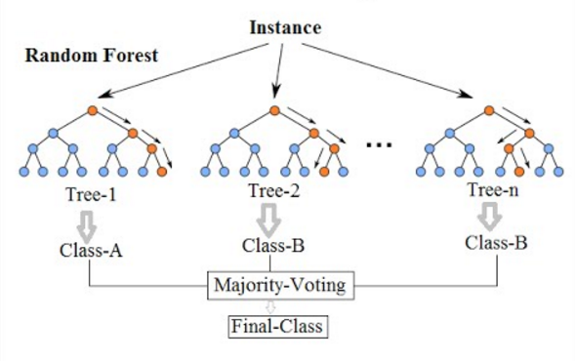
Random Forest Algorithm [RF]
Random forest, like its name implies, consists of a large number of individual decision trees that operate as an ensemble. Each individual tree in the random forest spits out a class prediction and the class with the most votes becomes our model’s prediction (see figure below).

Slide 7
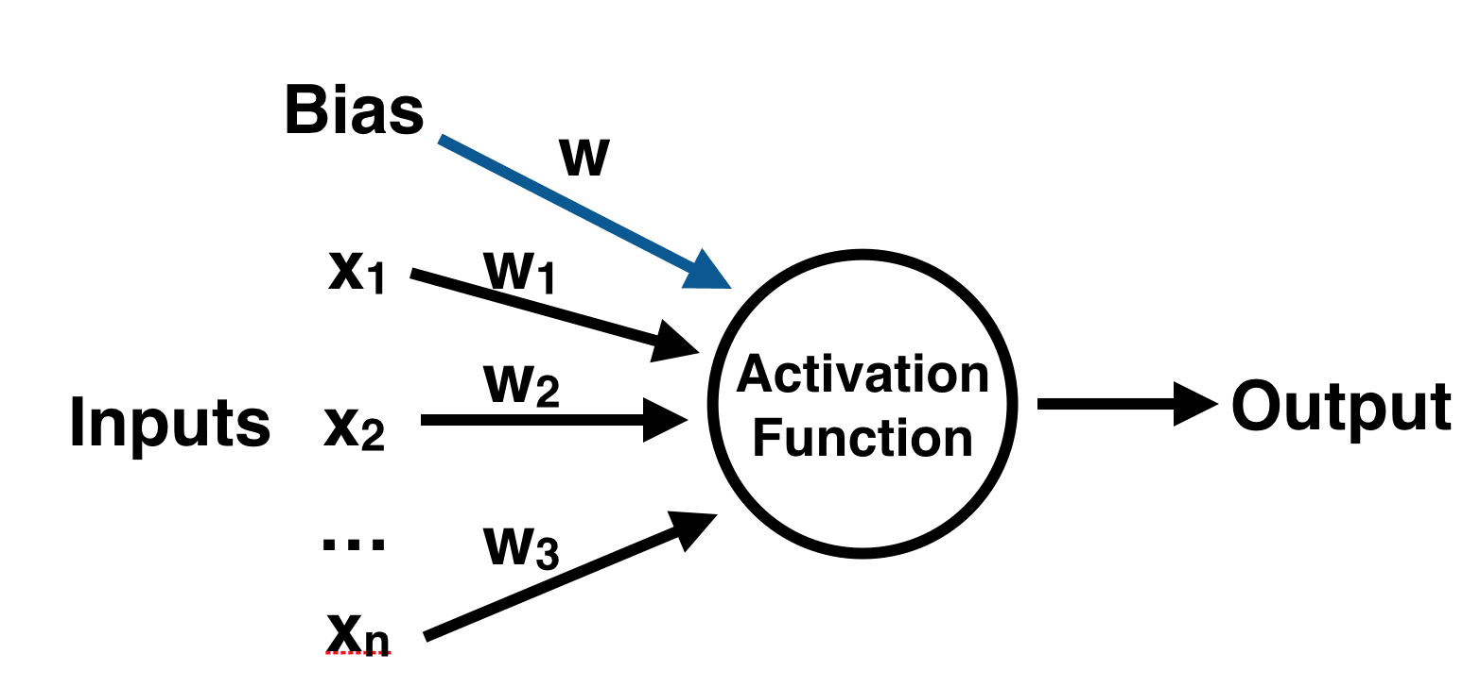
Neural Networks Algorithm [NN]
A perceptron has one or more inputs, a bias, an activation function, and a single output. The perceptron receives inputs, multiplies them by some weight, and then passes them into an activation function to produce an output.

Slide 8
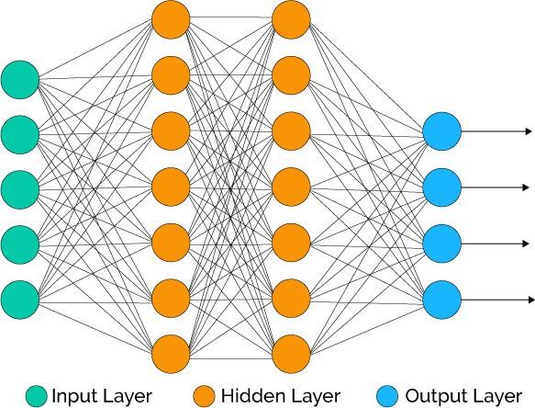
To create a neural network, we simply begin to add layers of perceptrons together, creating a multi-layer perceptron model of a neural network. You’ll have an input layer which directly takes in your data and an output layer which will create the resulting outputs.

Slide 9
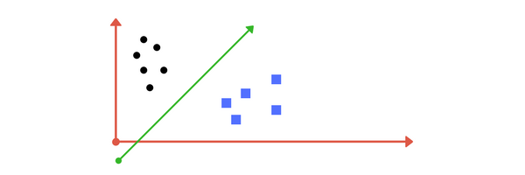
Support Vector Machine [SVM]
A Support Vector Machine (SVM) is a discriminative classifier formally defined by a separating hyperplane. In two dimensional space this hyperplane is a line dividing a plane in two parts where in each class lay in either side.
SVM can be extended to multidimensional space also.

Slide 10
Results - Without PCA
Accuracy F-score
RF
NN
SVM
0.9791 | 0.9894
0.9167 | 0.9565
0.85 | 0.8571

Slide 11
Principal Component Analysis [PCA]
Principal Component Analysis (PCA) is a linear dimensionality reduction technique that can be utilized for extracting information from a high-dimensional space by projecting it into a lower-dimensional subspace. It tries to preserve the essential parts that have more variation of the data and remove the non-essential parts with fewer variation.
For example You can use PCA to reduce that 4 dimensional data into 2 or 3 dimensions so that you can plot and hopefully understand the data better.
Other most important applications of PCA is for speeding up machine learning algorithms.

Slide 12
Results of RF algorithm after applying PCA
Principal Components | F-score | Accuracy
40% components | 0.8837 | 0.791
80% components | 0.9333 | 0.875
100% components | 0.8837 | 0.791

Slide 13
Results of NN algorithm after applying PCA
Principal Components | F-score | Accuracy
40% components | 0.8837 | 0.791
80% components | 0.9450 | 0.895
100% components | 0.875 | 0.933

Slide 14
Results of SVM algorithm after applying PCA
Principal Components | F-score | Accuracy
40% components | 0.9450 | 0.8958
80% components | 0.9450 | 0.8958
100% components | 0.9450 | 0.8958

